Slide 1
Idea-Hub
Stephen Russo, Benson Kuang, Tyler Rosemond, David Rafanan

Slide 2
What is Idea-Hub?
Unique, simple social media platform
Unites someone with an idea with someone with technical know-how
Matches two users based on criteria they specify

Slide 3
Status Quo
Many people have an idea for the “Next Big App”
Not everyone has the technical skillset required
Not everyone is managerial
Social Network may be limited
Kickstarter
Doesn’t facilitate entire development life cycle
Sole purpose is fundraising
Upwork
Crowdsourcing individual tasks can become tedious
Intellectual property can be compromised

Slide 4
Observations
Creativity stifled due to people thinking their idea is just a dream
Even if you receive funds to make your idea, difficult for average person to find someone with ability to make it a reality

Slide 5
Story Time
Joe is a person with an idea for a great new app
No idea how to make it
On the verge of giving up on the idea
John studies computer science in school and wants more experience
Not proficient enough to get a job
Looking for something to add to his portfolio
Currently, both have limited options

Slide 6
Insight
With advent of social media, easiest it’s ever been for people to meet and interact
More people than ever know how to produce applications
Widespread use of applications have inspired further application ideas

Slide 7
Welcome To IDea-Hub
Uses matching algorithm to match an “Initiator” with a “Technologist”
Both are given the opportunity to browse potential matches
When a successful match has been made, both can chat and development can begin
Upon conclusion of interaction, both are given the opportunity to leave a review or file a complaint

Slide 8
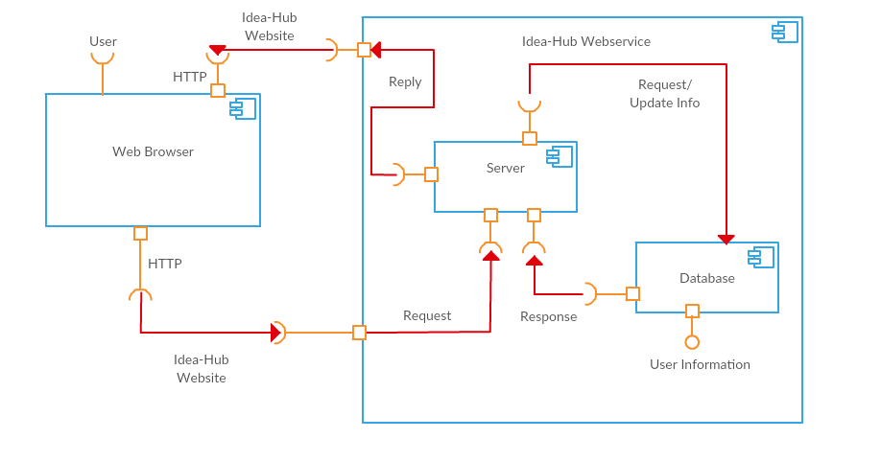
Set-up

Slide 9
Analogy
“Tinder” for software development
Matchmaking algorithm which pairs an initiator and an technologist
List of potential candidates
“Swipe” (swipe right) for ones you like
If technologists have the skills desired by the initiator
If initiators have projects that technologists want to build
If both people “swiped”, communication can begin

Slide 10
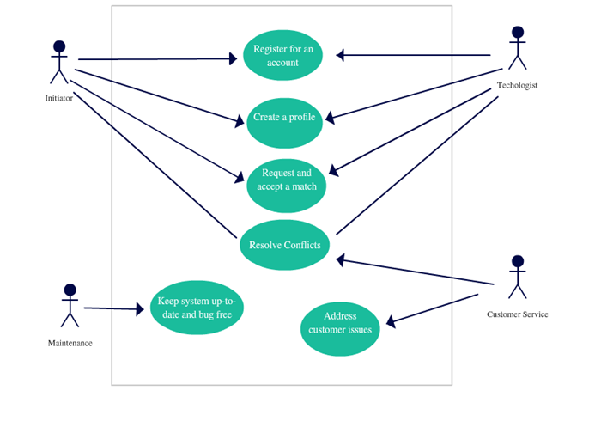
Design

Slide 11
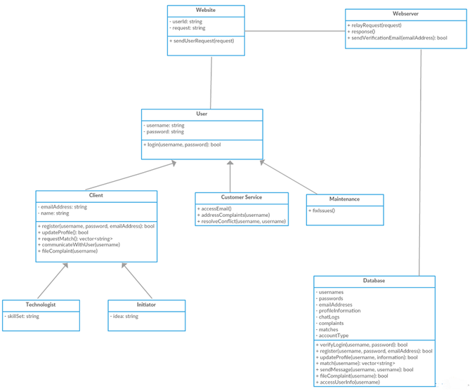
Class Diagram

Slide 12
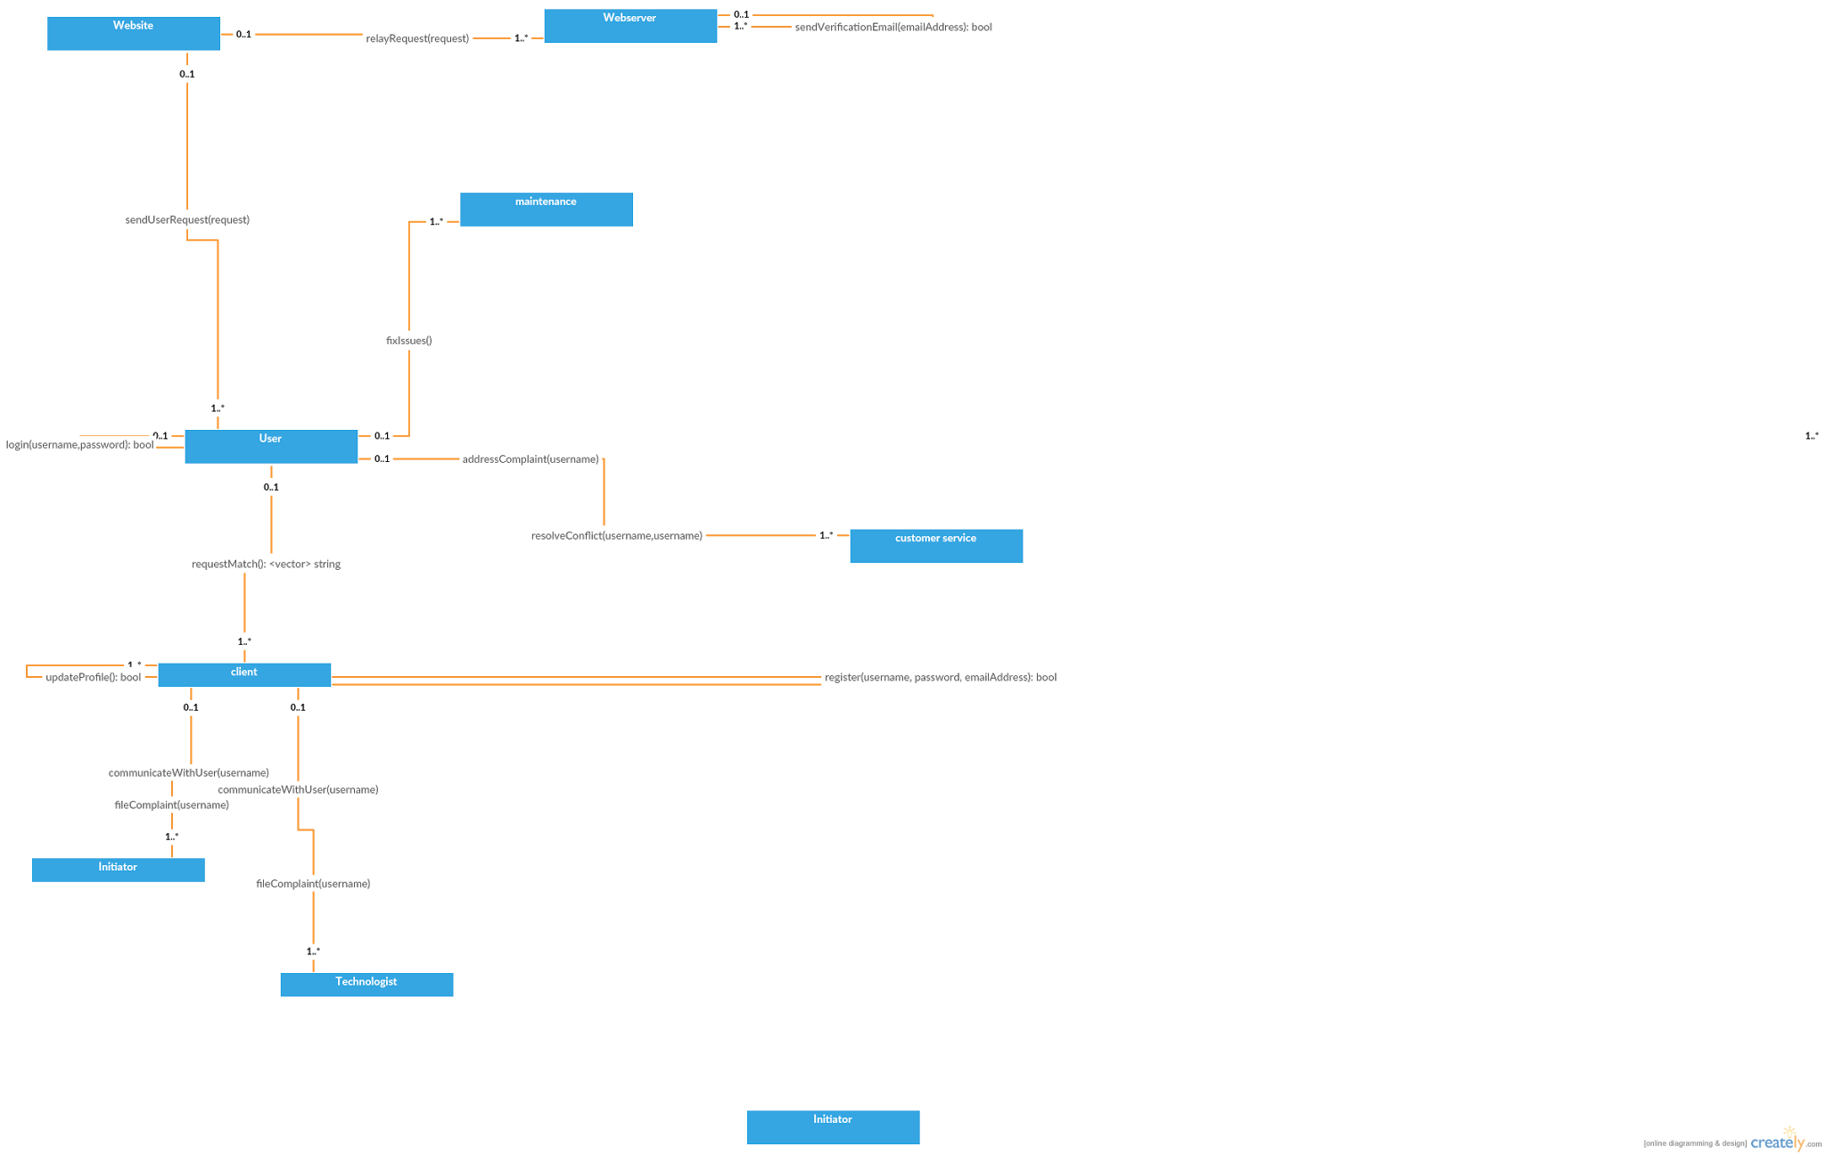
Relationship Diagram

Slide 13
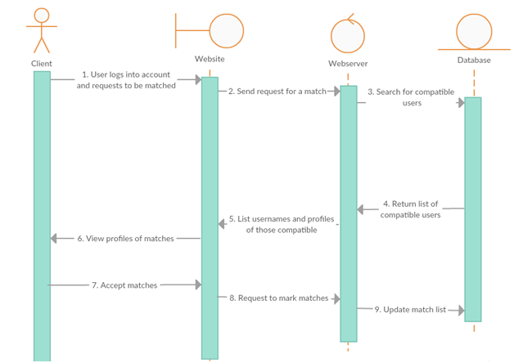
Sequence Diagram

Slide 14
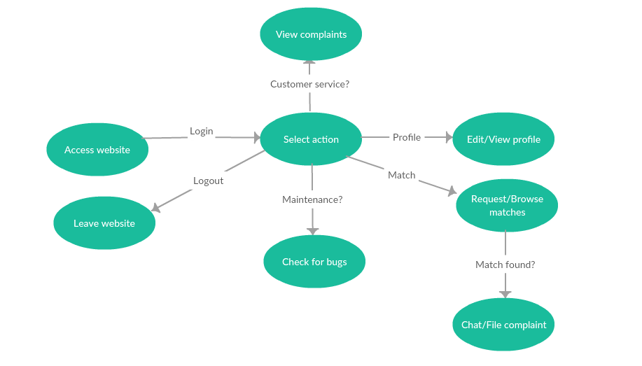
State Diagram

Slide 15
Advantage
Secure, privacy policy that will respect intellectual property
Chat logs will be stored to prevent abuse
System is first of its kind
No matching application for technical and creative minds
Simple to use
Create an account, fill in profile information, browse potential matches

Slide 16
Team Organization
Hybrid democratic team
Leader distributes work and submits
Alternate leader with each task
Egoless
Everyone’s opinion matters

Slide 17
Post Implementation Review
What we did right | What we did wrong | What we could change
Distributed work among members evenly Strong group communication Picked project we were all passionate about | Underestimated time needed for certain tasks Tried to implement too many features at once Issues arose late in implementation due to improper planning | Appoint a time for weekly team meetings Begin tasks earlier so more time is allotted to address issues In planning phase, discuss possible issues that may arise

Slide 18
Demonstration
Register
Create profile
Submit project idea
View matches

Slide 19
Future Work
Advertising
Key component of social media is userbase
Can’t work without users
Maintenance updates website to satisfy any unanticipated needs of users
Customer service helps users with any complaints or technical issues
Create an app

Slide 20
Features To Come
Chat
Foundation already exists
Issues with implementation caused it to be delayed
Customer Service and Maintenance
Need users in order for customer service and maintenance to be worthwhile
Design
Function over fashion
Sample of future look

Slide 21

Questions?

